Slide 1
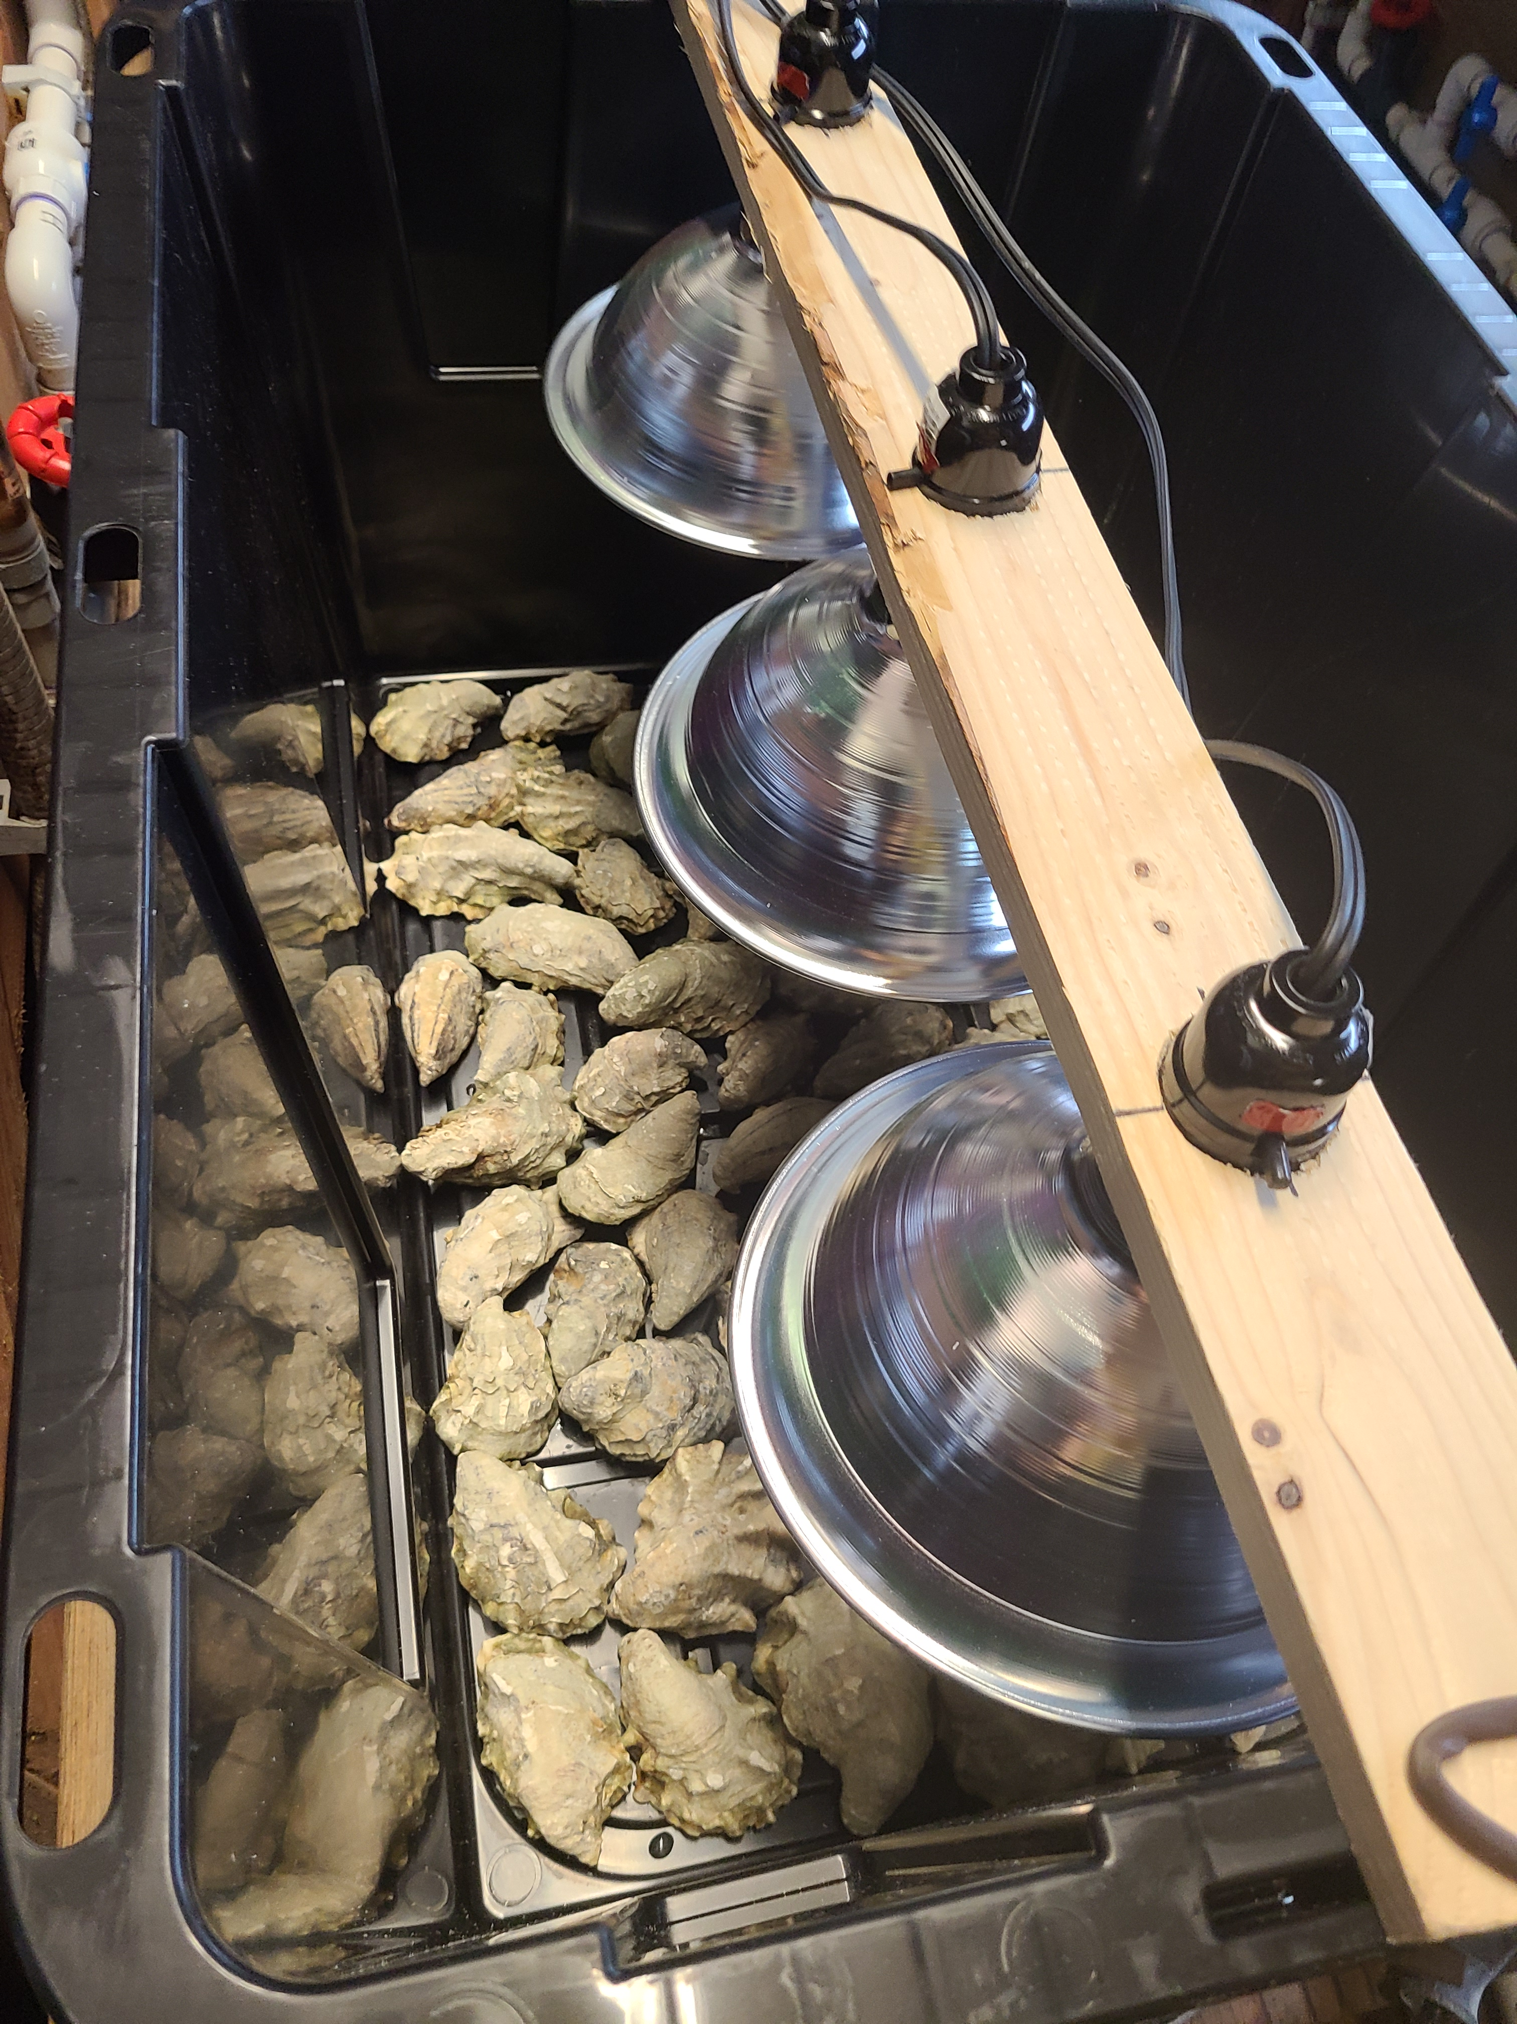
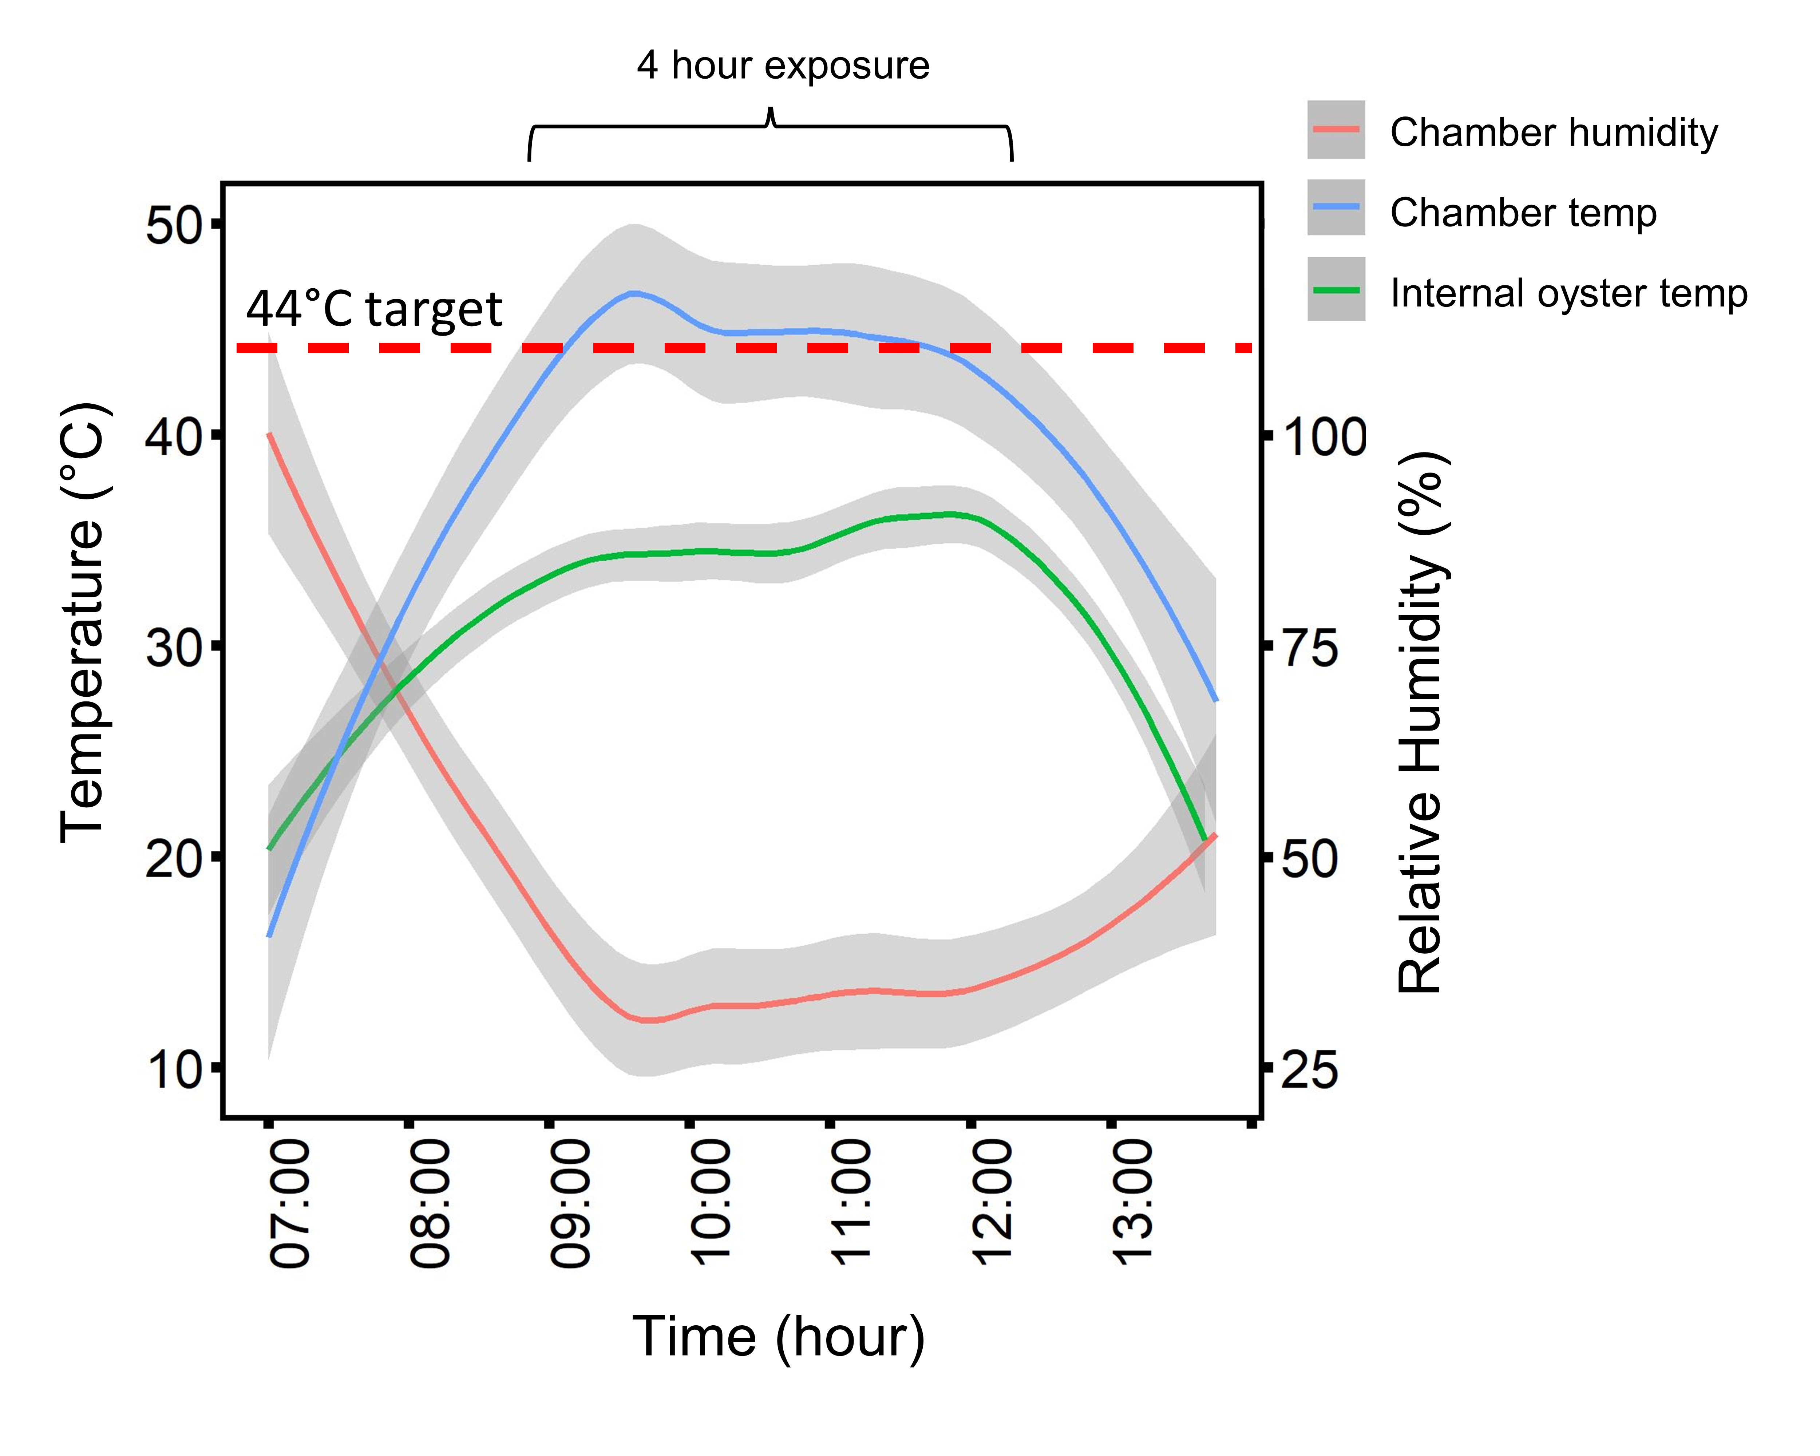
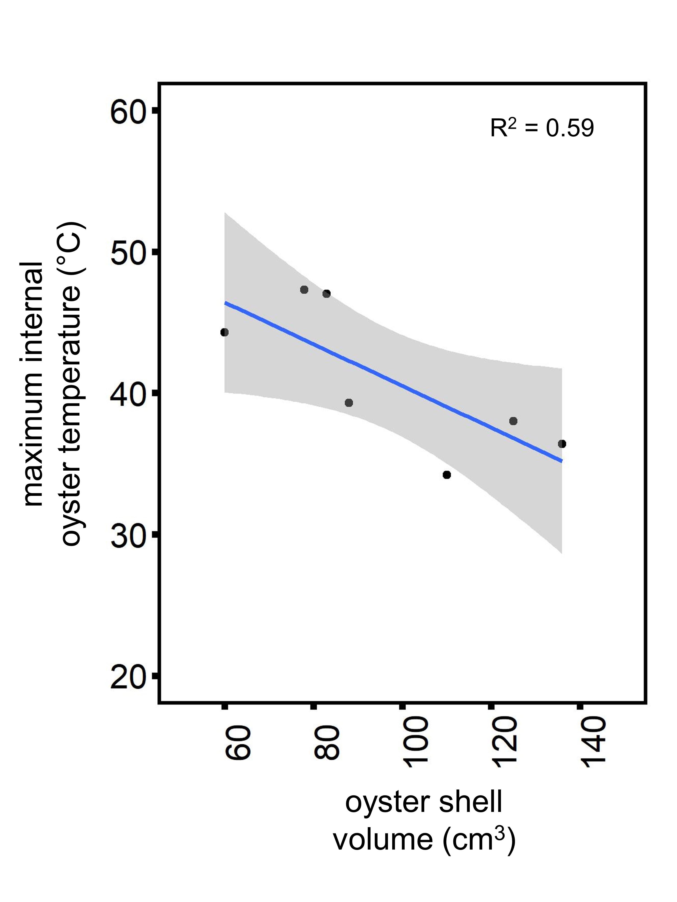
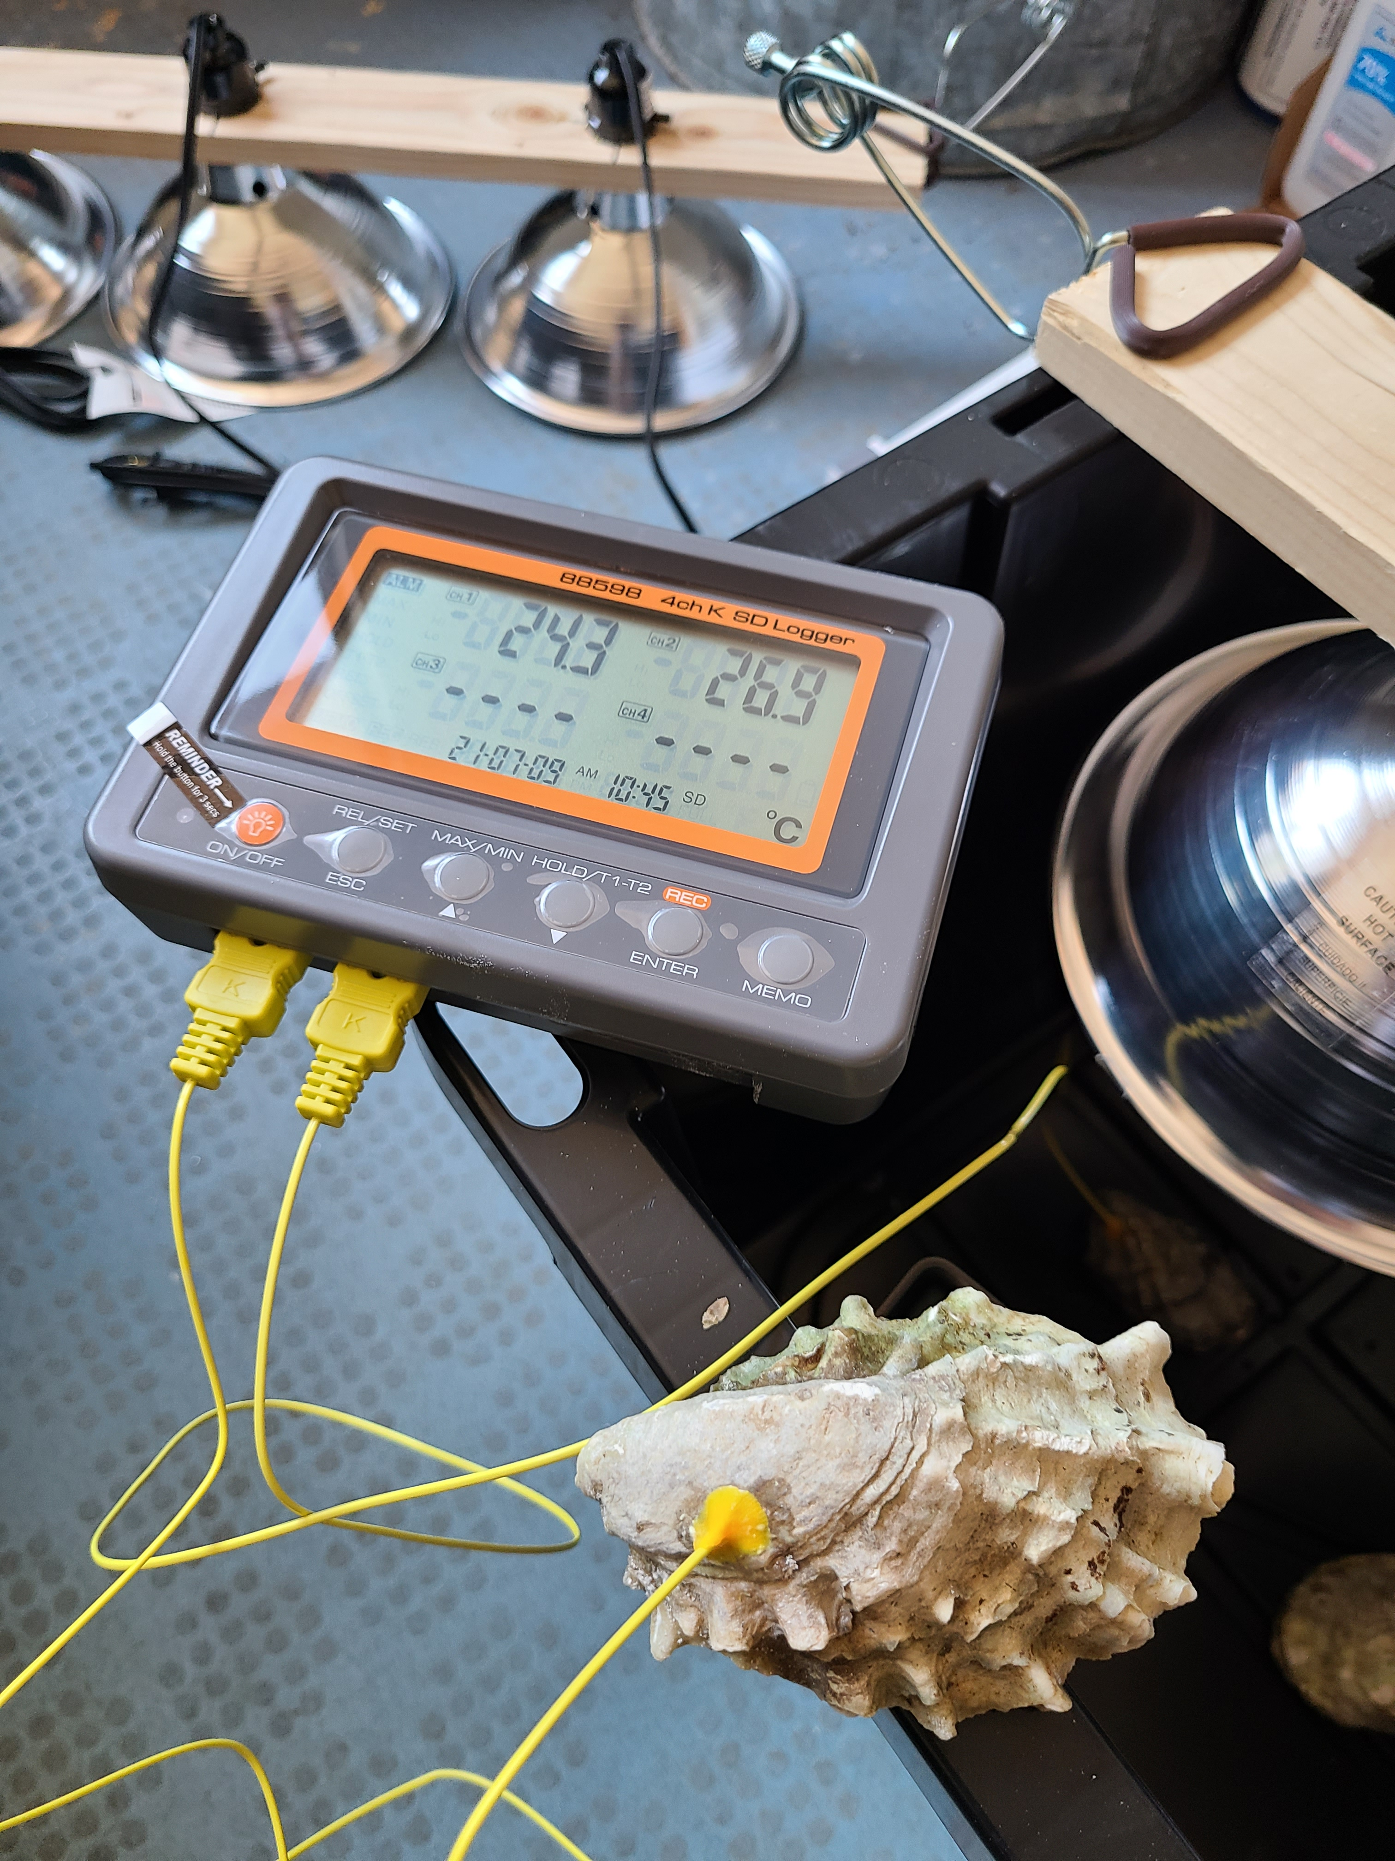
A
(1) Control
B
Start
End
-30d
-10d
(2) Ocean warming (OW)
Laboratory Acclimation
1d
(3) OW + desiccation
Temperature ramp to 30°C
2d
5d
10d
30d
Desiccation stress applied (4h, 44°C)
C
D
E

